Slide 1

Dataroadmap
Pathrise Project
Mehrnoush Ghasemi Ghonchehnazi
August 2023

Slide 2
Goals
Preparing a model to predict whether a fellow will be placed at a company.
Preparing a model to predict how long until a placement can be expected

Slide 3
Methodology
Data collection
Perform exploratory data analysis (EDA)
Perform data Preprocessing
Missing values
Outliers
Object (Categorical) data
Predictive Models for calcification targe (Goal#1)
Perform Supervised Learning
Linear Regression Model (Goal#2)

Slide 4
Data collection
Data is provided by Pathrise company in excel format.

Slide 5
Data Wrangling

Slide 6
Data Wrangling

Slide 7
Data Wrangling

Slide 8
Data Wrangling

Slide 9
Data Wrangling

Slide 10
Data Wrangling

Slide 11
Data Wrangling

Slide 12
Data Wrangling

Slide 13
Data Wrangling

Slide 14
Data Wrangling

Slide 15
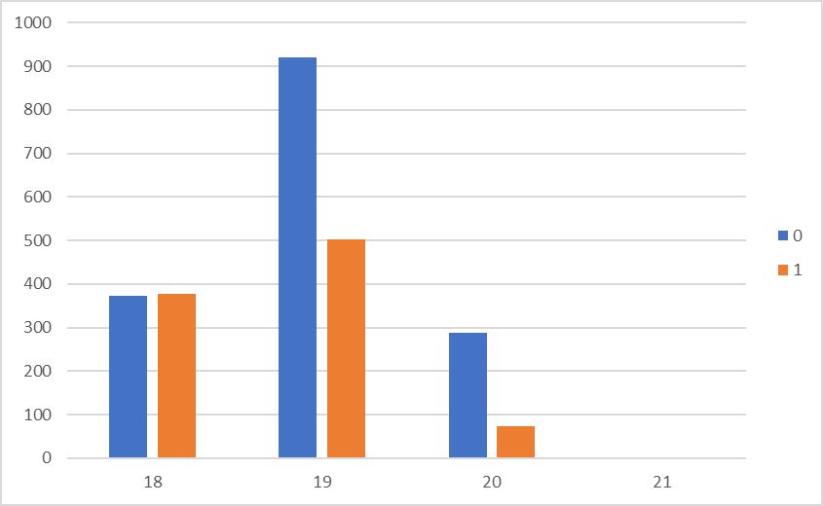
Data Wrangling
Columns deiced to delete:
ID
Pathrise_Status: Highly over correlated with Placed
Cohort_tag:
extracting new column “year”
from cohort_tag due to get better result.
So cohoret_tag has been omitted from data frame

Slide 16
Data Preprocessing Missing values
Imputation Missing values for Numeric features:
'program_duration_days' and 'number_of_interviews' are float and int feature. Simple and advanced methods imputations like Mean, median , K-Nearest Neighbor and Multivariate feature has been implemented to choose the best method.
Median is the best method for imputation

Slide 17
Data Preprocessing Missing values
Imputation Missing values for Object ( Categorical) features:
Probabilistic imputation involves replacing missing values with the most likely value based on the probability distribution of the non-missing values. One common way to achieve this is by randomly sampling values from the distribution of the non-missing values, weighted by their probabilities.

Slide 18
Data Preprocessing Outliers
Find Outliers:
Numeric Features: Boxplot, z_scores
number_of_applications>700 has been removed
Program_Out:42
Intreview_Out:43
Application_Out:3
Dealing with outliers: Remove outlier, Imputation , Use robust algorithms,…

Slide 19
Data Preprocessing Outliers
Find Outliers
Object Features: Value_counts

Slide 20
Data Preprocessing Object (Categorical) data
One-Hot Encoding (Get Dummies)
This approach is useful when dealing with categorical variables where there's no ordinal relationship between the categories.
Label Encoding:
This approach is suitable when dealing with ordinal categorical variables where there's a clear order or hierarchy among the categories.
Label Encoding has been selected to get the best result

Slide 21
Goal_1: Predict Models
Comparison of Accuracy in different models
Best Model : Random Forest
Data frame have Object features Random Forest may perform better.
Log. Reg | SVM | Decision Trees | Random Forest | KNN
0.64 | 0.66 | 0.76 | 0.77 | 0.62

Slide 22
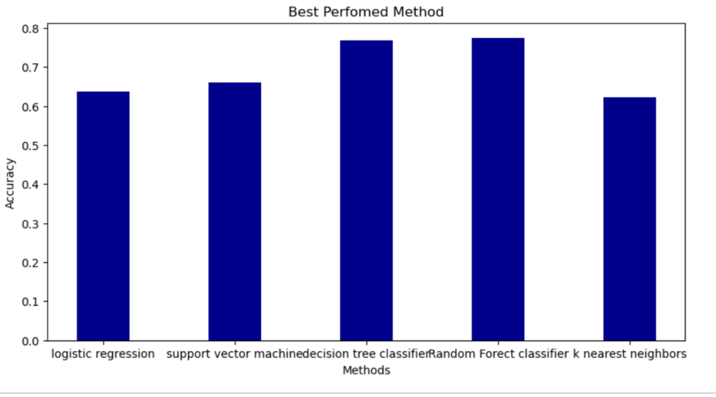
Predict Models

Slide 23
Predict Models
k
Comparison of confusion matrices in different models
K nearest neighbor
Logistic Regression
Support Vector Machine
Random Forest

Slide 24
Predict Models
Comparison of ROC curve

Slide 25
Goal _2: Preparing a model to predict how long until a placement can be expected.
Target column (needs to be predicted)= “Program_duration_day”
“Program_duration_day” is numerical ⇒ Therefore, Linear Regression Model should be used!
Only data with place=1 is analyzed.
Drop “placed” column.
Standardization before splitting.
X
Y
placed | primary_track | employment_status | highest_level_of_education | length_of_job_search | biggest_challenge_in_search | professional_experience | work_authorization_status | number_of_interviews | number_of_applications | gender | race | year | program_duration_days
0 | 3 | 4 | 5 | 1 | 2 | 0 | 1 | 6 | 0 | 2 | 6 | 2 | 112
1 | 1 | 2 | 4 | 3 | 1 | 3 | 1 | 0 | 0 | 2 | 2 | 1 | 0
1 | 3 | 0 | 0 | 3 | 2 | 3 | 1 | 5 | 25 | 2 | 1 | 1 | 0

Slide 26
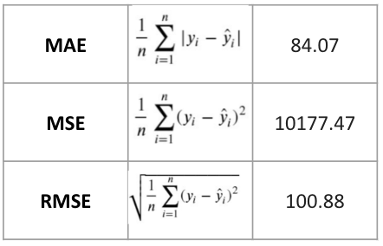
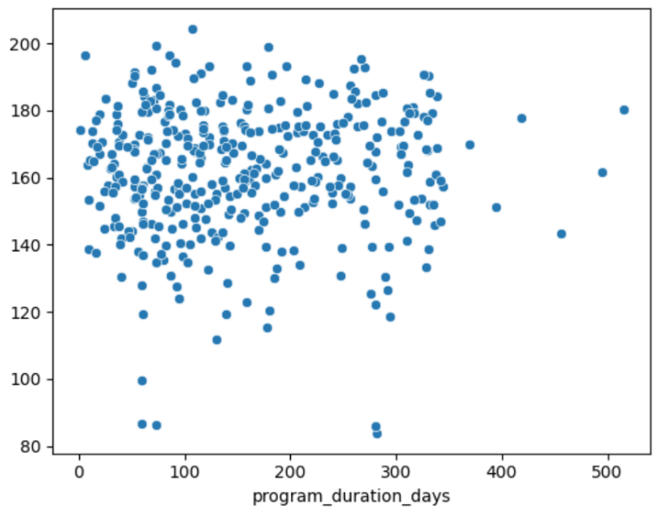
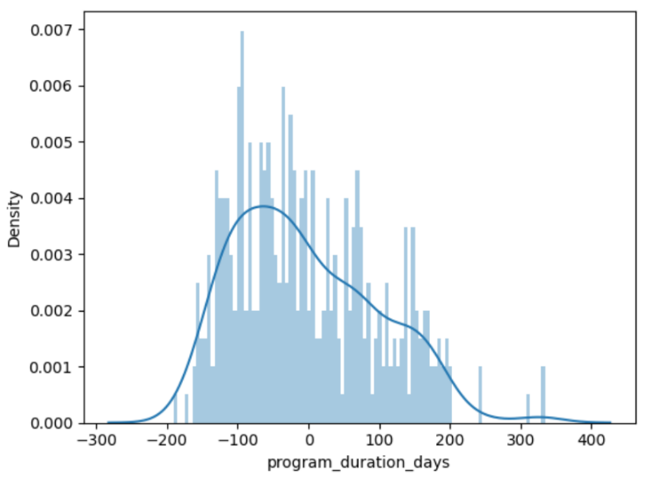
Results for Linear Regression
Predicted value

Slide 27
Thank you for your attention!

